Slide 1

General Biology
Dr. sraa nsayef

Slide 2
Animal Kingdom
Lec ((10))

Slide 3
Muscle
Epithelia
Nervous
Connective
Muscle
Muscle tissue: Three types
1-Skeletal muscle tissue:
2-Cardiac muscle tissue
3-Smooth muscle tissue

Slide 4
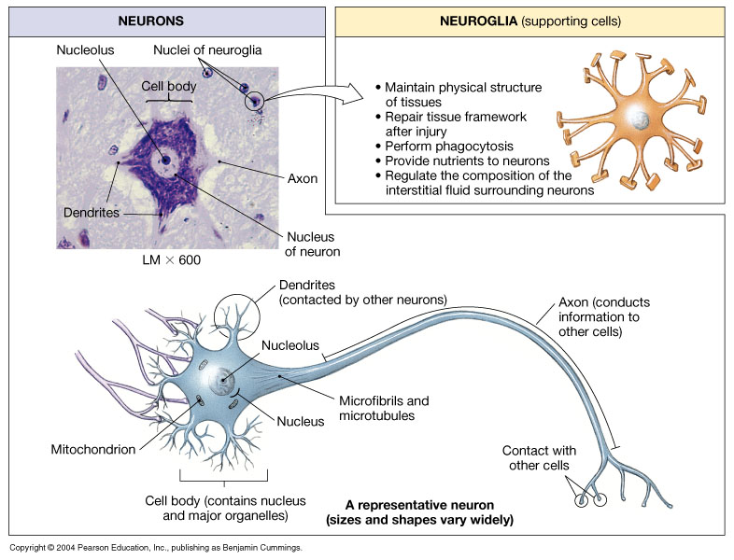
Neural tissue
Neural anatomy
1-Cell body Contains cell’s nucleus.
2-Dendrite: Extension that conveys signals towards the cell body.
3-Axon: Extension that transmits signals away from the cell body.

Slide 5
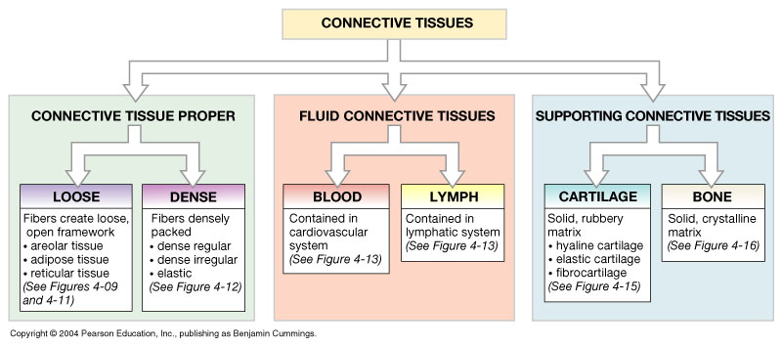
A Classification of Connective Tissues

Slide 6
Loose Connective Tissue (Areolar)

Slide 7
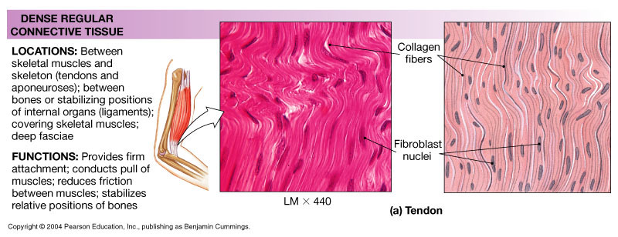
Dense Regular Connective Tissue

Slide 8
Adipose (Fat)

Slide 9
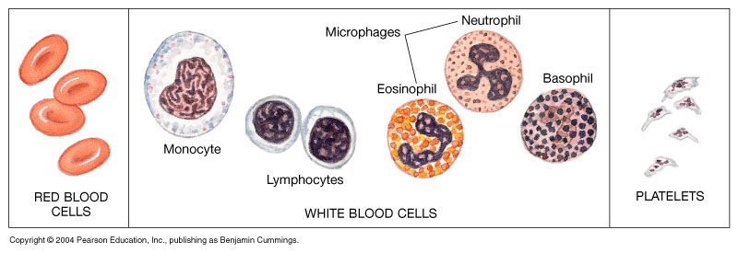

Slide 11
Hyaline Cartilage
Elastic Cartilage

